Slide 1

Cyber Security Awareness
-Naveen I P

Slide 2

What is Cyber Security?
Why Cyber Security?
How does Cyber Security works?
What is Cyber crime?
Cyber Crime Attacks
Types of Hackers?

Slide 3


Cyber Security Awareness
What is cyber security?

Slide 4




What is Cyber Security?
Cyber security is the technology and process that is designed to protect systems, networks, programs, devices and data from attack, damage or unauthorized access. And to get essential advantages.
Protection of your business
Avoids website damages & crashing
protecting client’s systems & data
Increased Productivity

Slide 5
Cyber Security Awareness
Why do we need cyber security?

Slide 6
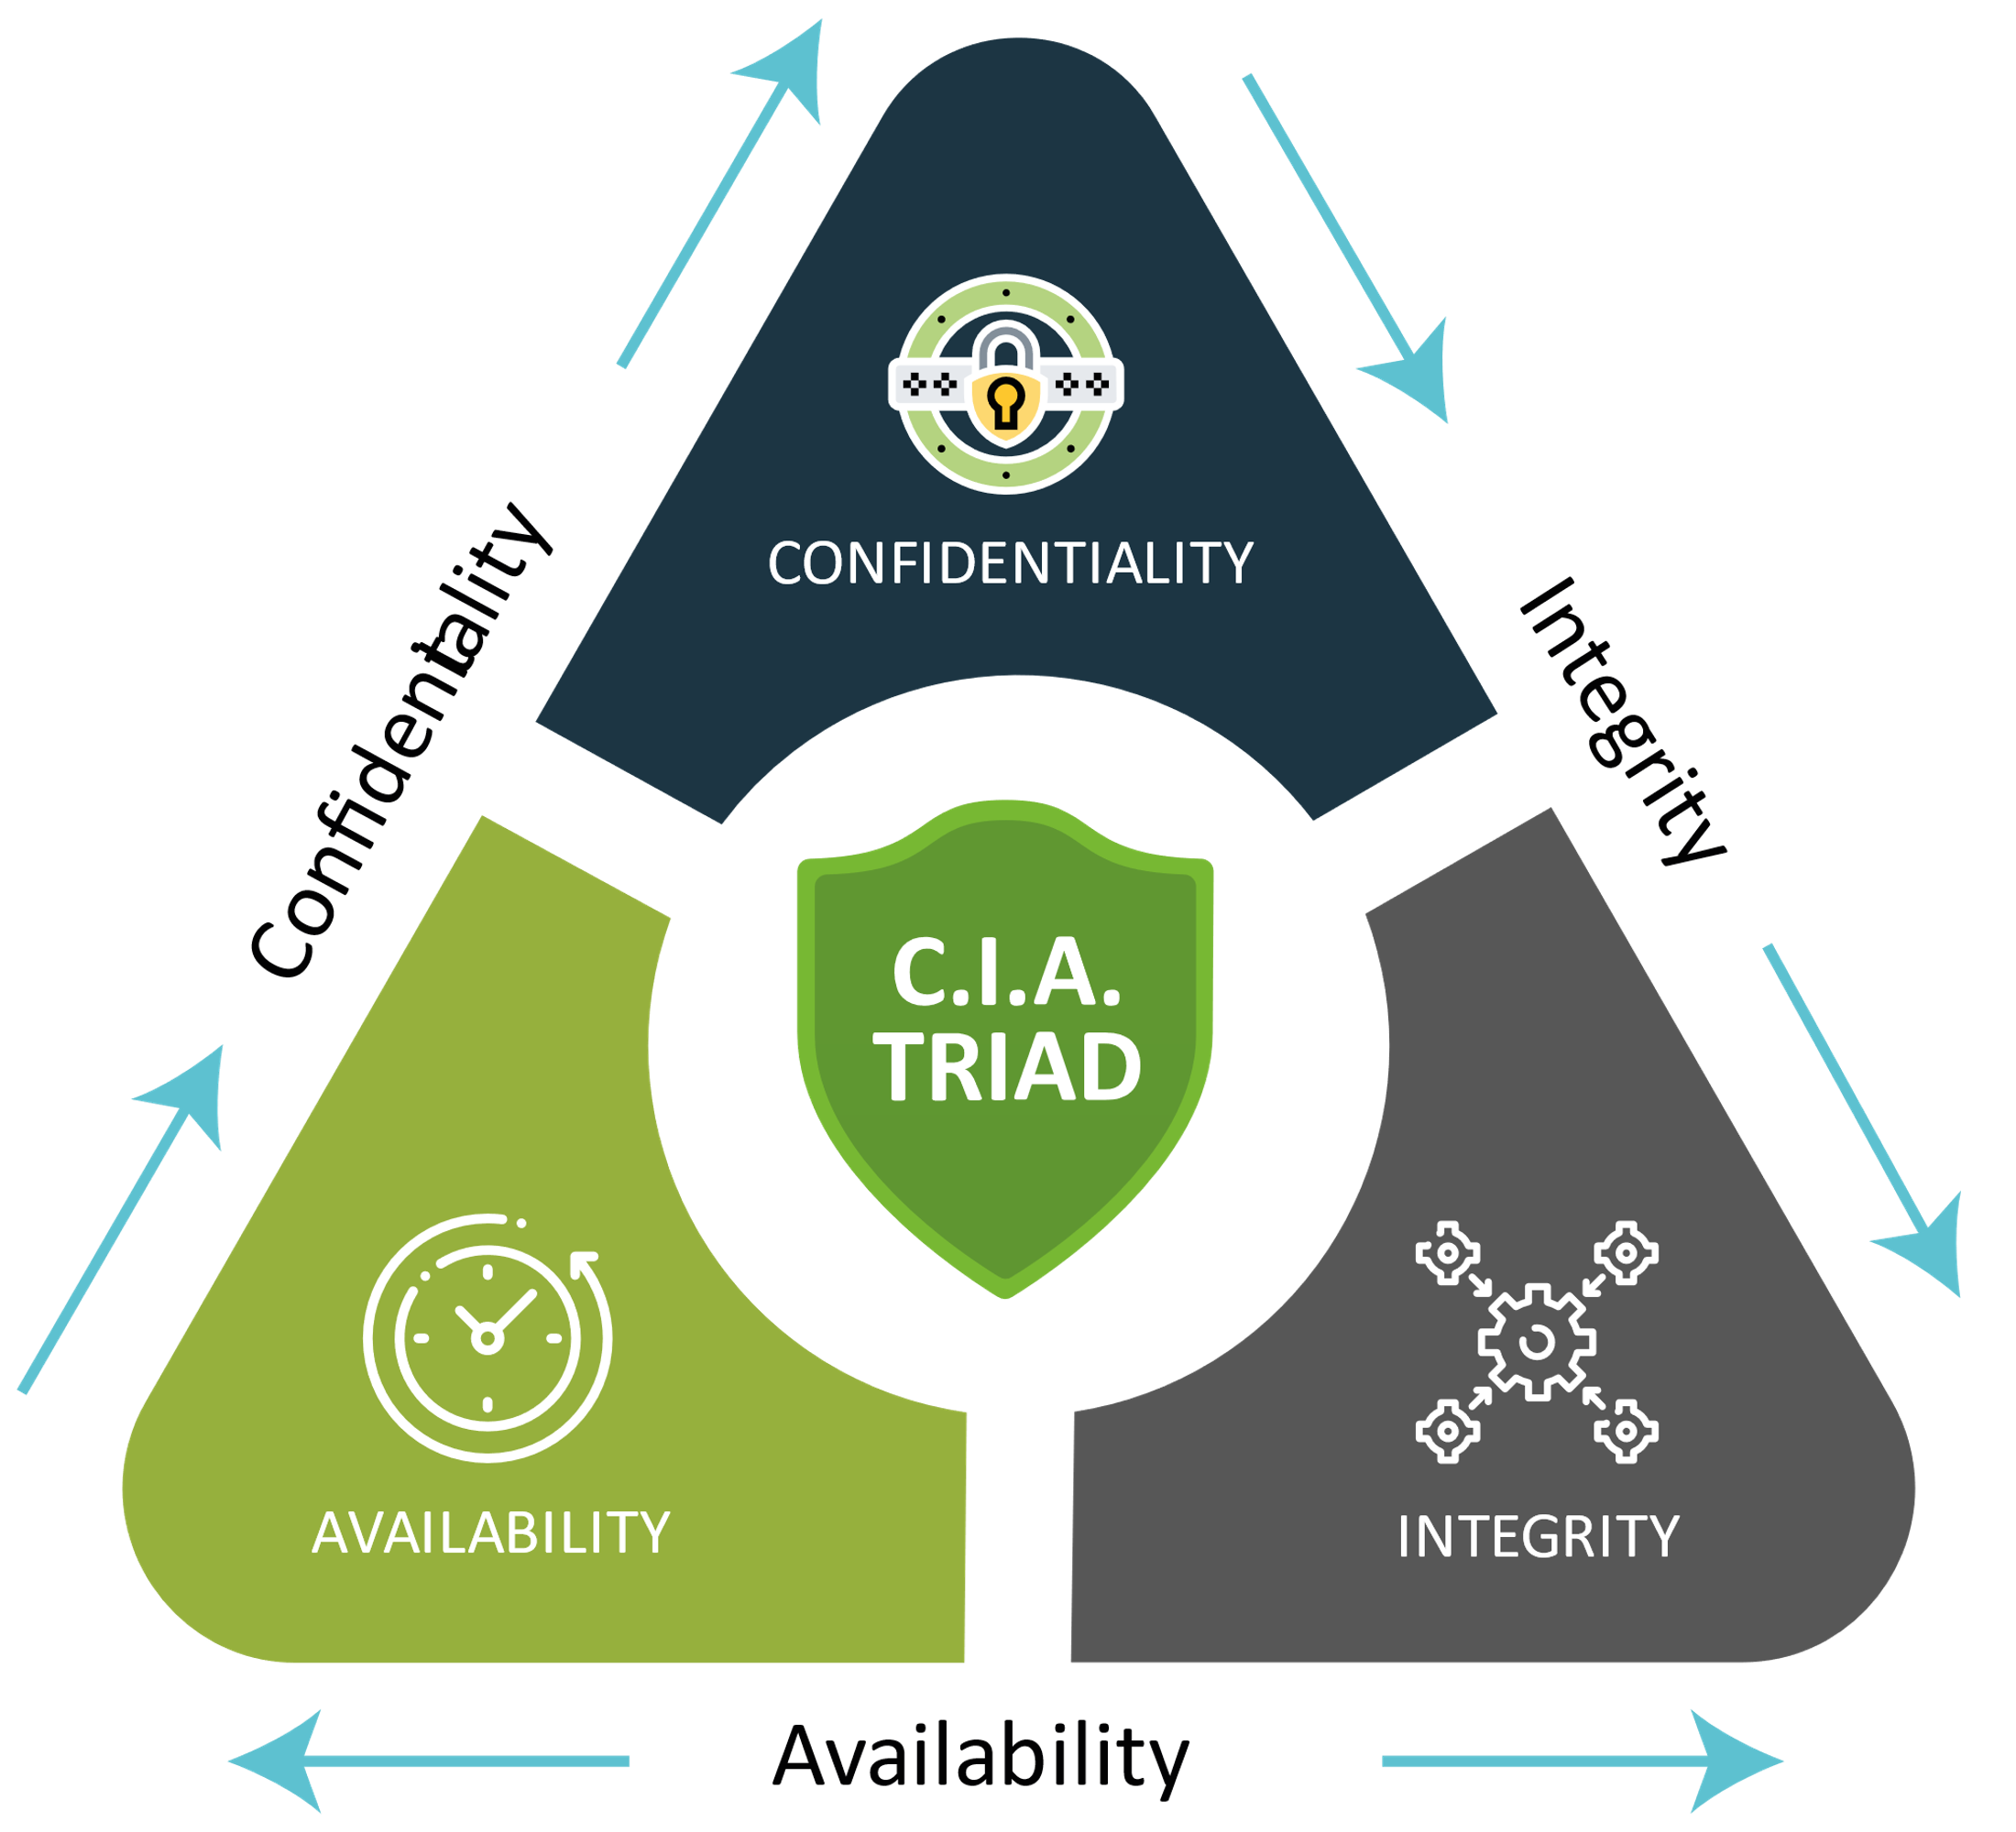
Why do we need Cyber Security?
In order to ensure Confidentiality, Integrity and Availability for computer or system Security
preserving authorized restrictions on access and disclosure, including means for protecting personal privacy and proprietary information.
Ex: two factor authentication
data or information in your system is maintained so that it is not modified or deleted by unauthorized parties. This is an important element of data hygiene, reliability and accuracy.
Ex: Incorrect data entered in database
Availability measures protect timely and uninterrupted access to the system. Some of the most fundamental threats to availability are non-malicious in nature and include hardware failures, unscheduled software downtime and network bandwidth issues.

Slide 7
Cyber Security Awareness
How does cyber security works?

Slide 8
How does Cyber Security works?
Securing System
Two-way Authentication
Secure Passwords
Regular Updates
Antivirus
Avoid Phishing
Cryptography
Firewall
Securing DNS

Slide 9
Cyber Security Awareness
What is cyber crime

Slide 10


What is Cybercrime?
It’s any criminal activity that involves a computer, network device or network
Cybercrimes are carried out in order to generate profit for the cyber criminals
Cybercrimes are carried out against computers or devices directly to damage or disable them, spread malware, steal secret information, etc.

Slide 11








Types of Hackers
White Hat
Black Hat
Grey Hat
Script Kiddie
Green Hat
Blue Hat
Red Hat
Hacktivist

Slide 12
Types of Hackers
White hat hackers are types of hackers who’re professionals with expertise in cybersecurity. They are authorized or certified to hack the systems. These White Hat Hackers work for governments or organizations by getting into the system.
The Black hat hackers are also knowledgeable computer experts but with the wrong intention. They attack other systems to get access to systems where they do not have authorized entry. On gaining entry they might steal the data or destroy the system.
The Gray hat hacker falls between the black and white hat hackers. They are not certified, hackers. These types of hackers work with either good or bad intentions. Grey hat hackers works for personal gain.
The Script Kiddies are amateur types of hackers. They try to hack the system with scripts from other fellow hackers. The intention behind the hacking is just to get the attention of their peers.
A green hat describes hacker wannabes who, though they lack technical hacking skills and education, are eager to learn the tricks of the trade.
Blue Hat Hackers are types of hackers who’re like Script Kiddies. They use hacking as a weapon to gain popularity among their fellow beings. The intent to learn is missing.
Red Hat Hackers are synonymous with Eagle-Eyed Hackers. They are the types of hackers who’re like to white hackers. The red hat hackers intend to stop the attack of black hat hackers.
Hacktivist types of hackers intend to hack government websites. They pose themselves as activists, so known as a hacktivist.

Slide 13
Cyber Attack
cyber attacks are attempts to expose, steal, change or destroy sensitive data or harm a network through unauthorized access.
These threats are designed to hurt companies — and sometimes even nations. The latter refers to damages caused by cyber warfare. The types of cyber attacks shown below can belong to one of these broader categories:
Denial-of-Service Attack: Those that shut down a site by overwhelming it with traffic from multiple sources.
Distributed Denial-of-Service Attack: When they use multiple computers to send traffic simultaneously to overwhelm the target website.
Malware Attack: In charge of installing malware on your computer that can steal information from you or your company.

Slide 14





Cyber Security Attack Practical Scenario
Email
Skype
Facebook
Employee might receive link
IT Security team might have identified that employee might have clicked on received link

Slide 15
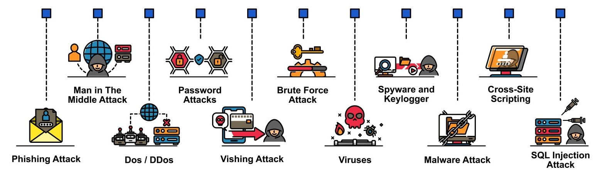
Most Common Cyber Attacks

Slide 16
Biggest Cyber attacks in history
RockYou2021: The biggest password leak yet – 2021
Cyberattack on Yahoo – 2014
Cyberattack on Marriott Hotels – 2014
Sony’s PlayStation Network attack – 2011
Uber data breach – 2016
Adobe cyberattack – 2013

Slide 17
Cyber Security Awareness
Thank You

Slide 18

Cyber Security Awareness

